Slide 1
Crow Simulation Error

Slide 2
Description
To further decrease error we examined the effects of removing certain hyperbolas from sections were they display the greatest error
Each contour plot shows a the decreasing error as we remove one hyperbola at a time, going up to the removal of three hyperbolas in the corner sections and two everywhere else.
After each plot, a chart will display the calculated error of each hyperbola in each section. This error is the average of errors from 1000 runs.
Small diagrams the right of the contour plot display the hyperbolas removed in each section.
In the last two sides, we determine if having a fourth microphone provides any extra information over having three microphones.

Slide 3
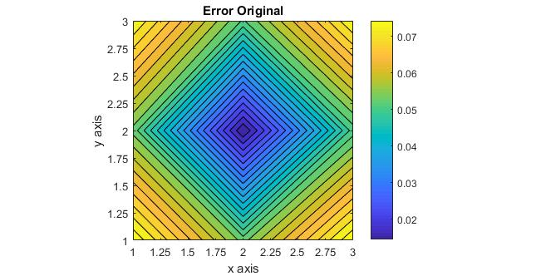
Error Original Form

Slide 4
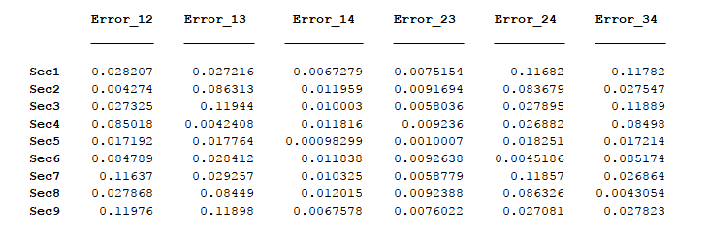
Master Error Average

Slide 5
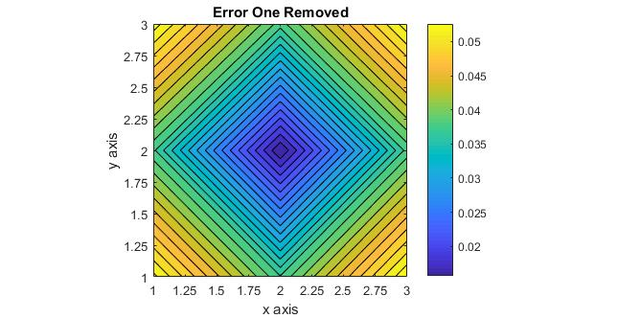
Largest Error Hyperbola Removed
3
Removed Hyperbolas
4
7 h_24 | 8 h_24 | 9 h_12
4 h_12 | 5 | 6 h_12
1 h_34 | 2 h_24 | 3 h_34
1
2

Slide 6
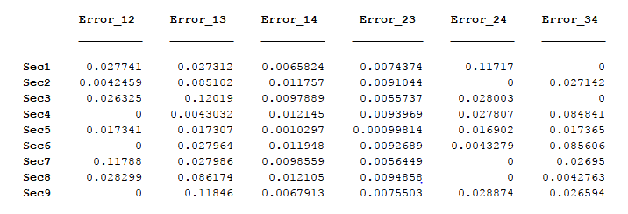
Master Error Average

Slide 7
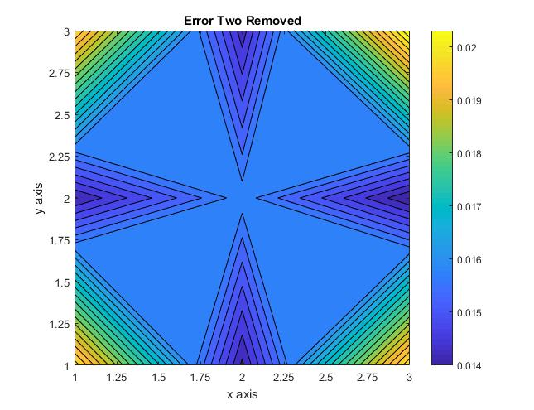
Two Largest Error Hyperbola Removed
3
Removed Hyperbolas
4
7 h_12, h_24 | 8 h_13, h_24 | 9 h_12, h_13
4 h_12, h_34 | 5 | 6 h_12, h_34
1 h_24, h_34 | 2 h_13, h_24 | 3 h_13, h_34
1
2

Slide 8
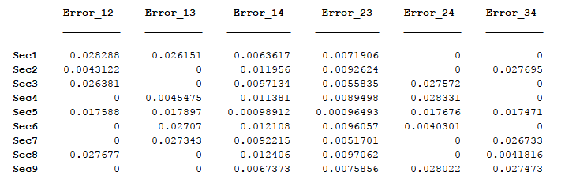
Master Error Average

Slide 9
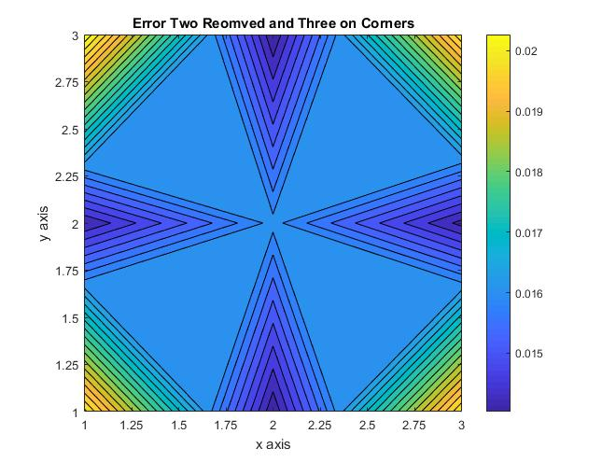
Two Largest Plus Diagonal Error Hyperbola Removed
3
Removed Hyperbolas
4
7 h_12, h_24 h_23 | 8 h_13, h_24 | 9 h_12, h_13 h_14
4 h_12, h_34 | 5 | 6 h_12, h_34
1 h_24, h_34 h_14 | 2 h_13, h_24 | 3 h_13, h_34 h_23
1
2

Slide 10
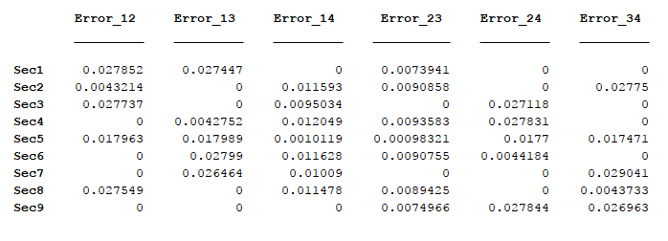
Master Error Average

Slide 11
Fourth Microphone Usefulness

Slide 12
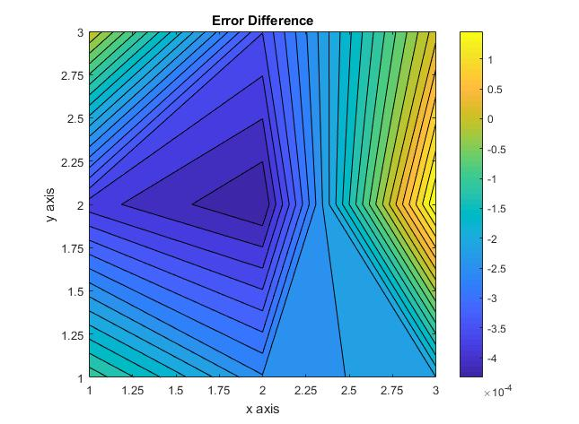
Error Difference
By not using h_14 and h_23, we are losing accuracy in the center

